Slide 1
Exoplanet Identification
By: Team CâNi

Slide 2
The problem
Space missions like Kepler, K2, and TESS generate thousands of candidate detections.
Each signal must be classified as Confirmed, Candidate, or False Positive.
Manual vetting is slow, inconsistent, and data is often noisy or incomplete.
As the data volume grows, scientists struggle to keep up

Slide 3
The Solution: Web App + Physics-Informed Transformer
Interface:
Web App for inference and explainability.
Input accepts missing values
Output shows:
Class probabilities (Confirmed / Candidate / False Positive)
Top-5 influential features (via SHAP-like attributions)
Top-3 most informative missing features (via VOI analysis)
Model:
Column-token Transformer trained on ∼20k labeled exoplanet samples.
Handles uncertainties, asymmetries, and missing features natively.
Auxiliary heads predict physical quantities: radius ratio, stellar density, equilibrium temperature, etc.
Physics-informed loss enforces consistency with astrophysical laws.

Slide 4
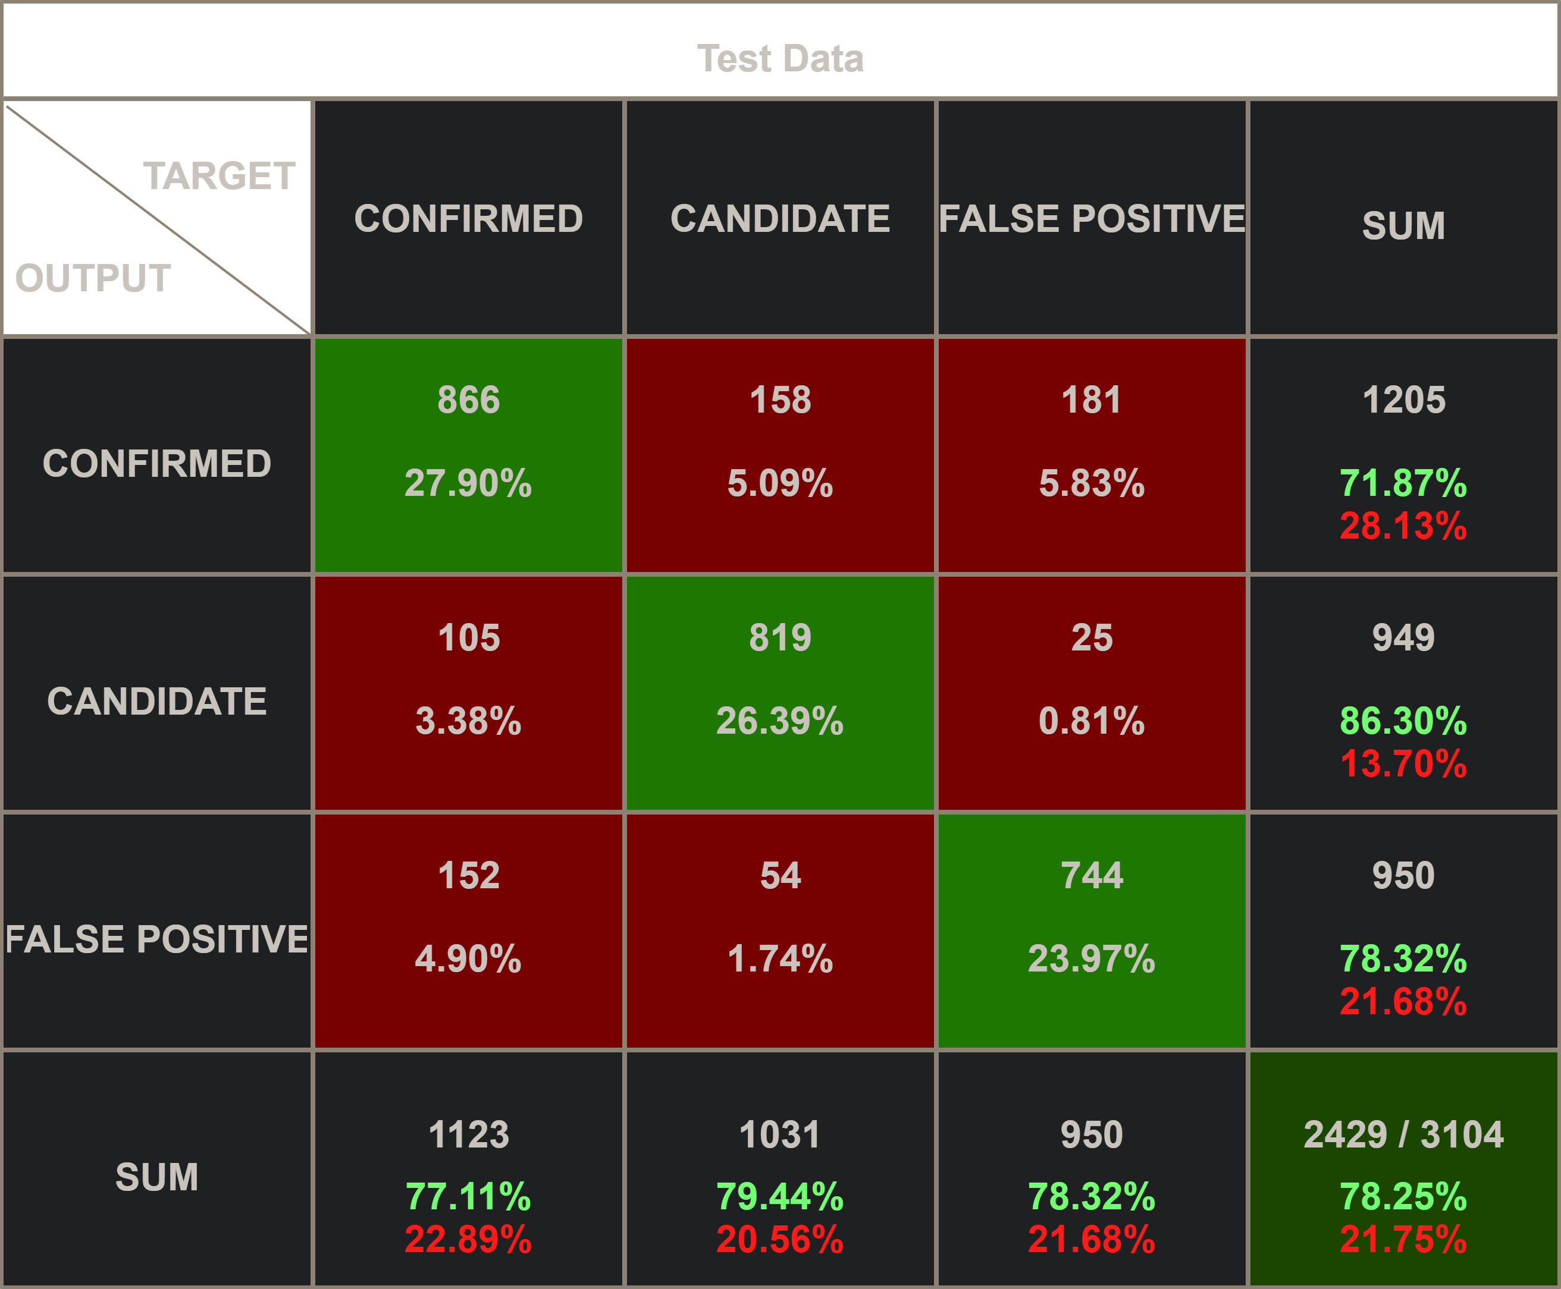
Model Results:
Validation Accuracy: 83.0% — Test Accuracy: 78.6%
Balanced performance across all 3 classes.
Physics-informed consistency improved generalization.

Slide 5
DEMO

Slide 6
THE IMPACT
Cuts validation time from weeks to minutes.
Produces interpretable predictions that align with physics.
Enables active learning: identifies which measurements to collect next.
Works across domains (Kepler, TESS, K2) with domain-agnostic embeddings.
Supports astronomers in turning raw light curves into confirmed worlds.

Slide 7
Summary
Problem: Too many exoplanet candidates, hard to manually validate.
Solution: Explainable Web Interface using a Physics-aware Transformer.
Impact: Trustworthy, scalable, and efficient discovery of new planets.

Slide 8
THANK YOU
Questions?

